Slide 1

Talyst 340B Review and Strategy
Stuart Murray

Slide 2
Agenda
Financial review 2014 340B Group
Talyst and 340B Goals for 2015
Team building exercise to develop personal and sectional goals in support of our Goals
Review Summary Document
Thanks for a great year!!!

Slide 3
340B 2014 Results

Slide 4
340B Business Unit: Achievement of 2014 Team Goals

Increase 340B revenue from $6.0M to $9.1M (2014 revenue expected to be $8M – a 36% year-over year increase)
Increase the positive market awareness of the Talyst 340B offerings
Document the Talyst 340B processes
Increase the automation and hands-free nature of Talyst’s Contract Pharmacy systems
Release a Fully Managed AutoSplit Desktop replacement product (Engaged with Health Unity for development study. Hired Mark Cassidy, VP Development & Todd Behrman, Product Management. Planning dedicated in-house development team for 2015)
Increase the knowledge level of 340B Team Members
Increase market awareness for the Talyst Audit & Compliance consulting product offering







Slide 5
340B Business Unit: 2014 Sales Wins
Pending agreements with CVS (Retail and Specialty) and Diplomat Specialty will bring substantial new opportunities for increased Contract Pharmacy revenue
Contract Pharmacy agreements with nearly all major retail chains
Kroger, Walmart, CVS, Safeway, Thrift White, Kinney Drug, etc.
Several big new Health Systems
Emory, Centura, Adventist Health System, Ascension Health System, Norton Health System, Los Angeles County, Inter Mountain Health
Specialty Contract Pharmacy Customers
UK, Froedtert, Univ. of Nebraska, University Health Louisiana, Region One Memphis, Dallas Children's, Owensboro, Emory, UVA, Opelousas, Riverside
Audit and Consulting helping to win / retain business – Talyst customers have a perfect HRSA audit record!
St. David’s, Atlanticare, Long Island Jewish, Wheaton, UK, Santa Clara, Sharp

Slide 6
340B 2014 Product Development Challenges & Successes
Personnel Issues disrupted 2014 development plans (Lost 2 out of 3 developers: Bryce Morsello & Ron Sanders as well as VP Development, Frank McKeown)
Specialty Contract Pharmacy has required additional development (Accredo / Hemophilia / Specialty Distributor interfaces, etc)
Hired new VP Development (Mark Cassidy) and Product Development resource (Todd Behrman)
Substantial effort towards 340B Enterprise architecture and initial requirements. Preparing for serious development effort in 2015.
Engaged Health Unity in a consulting arrangement for HL7 / patient name matching demonstration project
Developed a plan and materials for 340B Enterprise Competitor Analysis project

Slide 7
340B Business Unit: 2014 Achievement vs. Plan
Sales bookings have been on-target with an emphasis on FM over Desktop
Forecasting total 2014 AutoSplit™ sales bookings of $2.12M, right on plan
AutoSplit revenue tracking below plan
Forecasting total 2014 AutoSplit™ revenue of $6.1M, below plan of $7.2M but an increase of $1.2M over 2013’s $4.9M
New 340B regulations requiring Covered Entities to re-certify each year caused unusually large number of terminations (20 DT, 6 FM = 26)
Contract Pharmacy revenue is expected to meet plan
Expecting $1.85M in 2014 Contract Pharmacy revenue
Sales bookings have been strong and are growing
137 ordering pharmacies for Contract Pharmacy, including 8 Specialty
Operating expenses are well below budget
Forecasting total 2014 operating expenses of $3.5M, $0.7M below plan, mostly due to unspent R&D
Expect EBITDA of nearly $4M
Forecasting $4M in 2014 EBITDA, $0.5M below 2014 plan but $1M increase over 2013 actual

Slide 8
2014 340B P&L Forecast

Slide 9
340B 2014 Sales Bookings
We are confident in achieving our 2014 sales bookings plan
Team focused on selling both AutoSplit products (DT & Fully Managed) FM represents about 2/3 of new sales
New sales reps hired in August already closing significant deals
Ability to utilize Specialty Pharmacy as “foot-in-the-door”. Expecting this area of Contract Pharmacy to show strong growth in 2015
Ever increasing interest in Audit & Compliance services

Slide 10
340B Sales Bookings Annual Trend Summary

Slide 11
340B 2015 Financial Plan

Slide 12
340B Business Unit: 2015 Plan Overview
AutoSplit revenue projected to grow 23% from $6.1M in 2014 to $7.6M in 2015
Expecting significant growth in Fully Managed
Large existing backlog of signed Fully Managed contracts expected to be implemented over the next several months
Desktop revenue not expected to grow significantly as we continue to focus sales efforts on Fully Managed revenue at higher price points
Budgeting a 10% attrition rate in Desktop, including accounts that convert to Fully Managed
Contract Pharmacy revenue projected to grow 170% from $1.8M in 2014 to $4.8M in 2015
Expecting $3.3M in 2015 “Retail” Contract Pharmacy revenue
Budgeting 200+ active retail pharmacies by end of 2015, up from 130 at end of 2014
Expecting $$1.5M in 2015 “Specialty” Contract Pharmacy revenue
Budgeting 28 active Specialty pharmacies by end of 2015, up from 8 at end of 2014
Increased operating expenses to accommodate revenue growth and product development efforts
Adding 14 total headcount, mostly in product development and operations
Increasing budgets for outsourced development, tradeshows and marketing
Expect EBITDA of nearly $5.6M, up from $4.0M in 2014

Slide 13
2015 340B P&L Plan

Slide 14
2015 340B Headcount Plan
Headcount growth in 340B required to accommodate growth & rebuild/build
the product platform
6 new heads in operations for both Fully Managed and Contract Pharmacy
6 new heads in product development to build the new online hosted platform
2 new heads in sales & marketing to handle sales volumes

Slide 15
340B 2015 Business Overview
Confidential

Slide 16
Mega Rule turns into Tiny Suggestion
For over a year, participants in the 340B Drug Pricing Program (340B Program) and others have been waiting for the release of the so-called proposed “Mega-Rule”.
On May 23, 2014, the U.S. District Court for the District of Columbia vacated a final rule in which the agency gave its interpretation of the orphan drug exclusion under the 340B Program.
The Court found that while Congress gave HHS specific authority to issue 340B Program regulations to (1) establish an administrative dispute resolution process, (2) provide defined standards of methodology for calculating ceiling prices, and (3) address the imposition of civil monetary penalties, it “has not given HHS the broad rulemaking authority” or other specific authority to issue the orphan drug exclusion rule disputed in the case.
How the agency decides to proceed with the orphan drug exclusion rule will no doubt provide some insights on whether the agency will proceed with the proposed Mega-Rule, or will instead continue to administer the 340B Program through interpretative guidance.

Slide 17
Orphan Drugs
The U.S. Department of Health and Human Services, in tandem with the Health Resources and Services Administration (HRSA), issued an interpretive rule on July 21, 2014 regarding the 340B program and orphan drugs. Such drugs are available through the 340B program to free-standing cancer hospitals, critical access hospitals, rural referral centers and sole community hospitals.
Although that rule is technically nonbinding, the agency has threatened drugmakers with severe punishment if they violate the statutory language that covers 340B.
On October 9, 2014, the Pharmaceutical Research and Manufacturers of America (PhRMA) trade organization filed another lawsuit against the U.S. Department of Health and Human Services (HHS) over a controversial orphan drug rule that is part of the 340B drug discount program for safety net hospitals.

Slide 18
340B Split Billing Market Share

Slide 19
340B Covered Entity Segmentation

Slide 20
Growth of 340B Contract Pharmacy
50,616 Registered Contract Pharmacies as of November 7, 2014

Slide 21
340B Contract Pharmacy by Chain
Walgreens 22,430
November 7, 2014

Slide 22
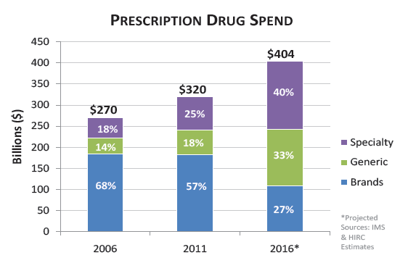
Specialty Market
Average Specialty Prescription Cost = $2,654

Slide 23
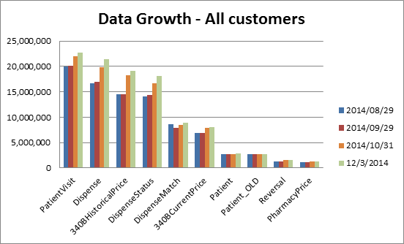

Slide 24
Appendix – 340B 2015 Financial Plan Detail
Confidential

Slide 25
340B 2015 Desktop & Fully Managed Revenue Plan

Slide 26
340B 2015 Contract Pharmacy Revenue Plan

Slide 27
340B 2015 Operating Expense Summary by Department

Slide 29
340B Business Unit: Achievement of 2015 Team Goals
Increase 340B revenue from $8M to $12M
Increase customer satisfaction and retention by at least 10%
Improve internal operational efficiencies by at least 10% (e.g. improved invoicing, reduced implementation time)
Increase the 340B savings for Talyst’s customers by at least 10% (e.g. reduce the WAC %, increase CP match rates)
Improve the interdepartmental processes and efficiencies (i.e. Sales to Implementation to Support; finance; development)
Improve training and increase the 340B knowledge level for all team members
Support the development and deployment of a 340B Enterprise replacement product (AutoSplit and Contract Pharmacy)
… and develop metrics to track our progress

